Slide 1
VOTING 2020
SAFE AND SECURE OPTIONS

Slide 2
IMPORTANT DATES
9 Oct
VOTER REGISTRATION
You may register in person at an Early Voting Site if you missed this deadline!
27 Oct
REQUEST ABSENTEE BALLOT
3 Nov 5:00 PM
BALLOTS POSTMARKED
15–31 Oct
EARLY VOTING
You may vote at any polling location that is convenient for you
3 Nov
ELECTION DAY

Slide 3
VOTER REGISTRATION
ONLINE: Register online via DMV if you have a NC driver’s license or DMV-issued ID.
BY MAIL: Access and print the voter registration form via the NCSBOE website (https://www.ncsbe.gov/Voters/Registering-to-Vote)
IN PERSON - EARLY VOTING SITE: Take proof of address; rent slip, utility bill, mortgage statement

Slide 4
MAKE SURE TO CHECK
YOUR REGISTRATION ONLINE
https://www.ncsbe.gov/registering/checking-your-registration

Slide 5
ABSENTEE VOTING AND MAIL-IN VOTING ARE THE SAME THING
No!

Slide 6
ABSENTEE BALLOTS
Request
Request Your Absentee Ballot Online
The Absentee Ballot Request Portal.
Track
Track Your Absentee Ballot
Voters who vote by mail may use BallotTrax
Contact
Contact your County Board of Elections
Text Alerts

Slide 7
IMPORTANT TO NOTE!
MAT TEAMS
A Multipartisan Assistance Team, or “MAT,” is a group appointed by a county board of elections to assist with mail-in absentee voting and other services to voters living at facilities such as hospitals, clinics and nursing homes.
If you request help from a MAT, you should receive impartial, professional assistance. Their job is to help you vote, but your voting choices will remain confidential.

Slide 8
Provides voter registration services
Request an absentee ballot
Serve as an absentee witness
Mark the absentee ballot
Seal the ballot and complete the absentee application & certificate (envelope)
Mail the voted absentee ballot in the closest U.S. mail depository or mailbox, if the voter has a disability
MAT TEAM ASSISTANCE
MULTIPARTISAN ASSISTANCE TEAM

Slide 9
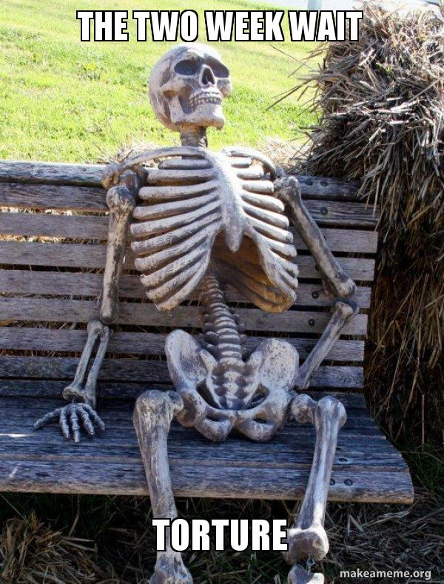
DON’T WAIT
until Oct. 27
to request
your absentee ballot

Slide 10
IMPORTANT TO NOTE!
ABSENTEE BALLOT REQUEST FORM
Please provide a phone number or email
Request this as early as possible

Slide 11
FILLING OUT YOUR BALLOT

Slide 12
FILLING OUT YOUR BALLOT
USE A BLACK BALL POINT PEN
IF YOU TEAR, DEFACE (watch the coffee), OR WRONGLY MARK THE BALLOT, DESTROY IT AND CALL YOUR COUNTY BOARD OF ELECTIONS FOR A REPLACEMENT.
REQUIREMENTS

Slide 13
IMPORTANT TO NOTE!
OOPS I MESSED UP!
3 strikes and you’re OUT to vote absentee (can vote in-person)
If you realize you made a mistake you want to change after you submitted your ballot – too late. It will be cast as is
If you double marked a race and have submitted, that race only is not counted

Slide 14
FILLING OUT YOUR BALLOT
Need only one (almost anyone!)
18 years of age
Need not be a registered voter
Cannot be a candidate for public office
If the voter is a patient or resident at a hospital, clinic, nursing home, or adult care home, the following individuals are also prohibited from assisting:
an owner, manager, director, or employee of that facility; an individual who holds any elected federal, state or local office or precinct political party or organization office;
or a campaign manager or treasurer for any candidate or political party.
No Notary Public necessary
THE WITNESS REQUIREMENT

Slide 15
ONLY ONE STAMP IS NEEDED: a 55¢ stamp (first class stamp) OR one Forever stamp.
YOU WILL BE CONTACTED IF THERE IS A PROBLEM WITH YOUR BALLOT
VOTE AND MAIL IT EARLY

Slide 16
IMPORTANT TO NOTE!
TRACKING YOUR BALLOT
Sign up for BallotTrax & text alerts
Go to NC Board of Elections site to view your status
“Requested,” “Received,” “Accepted”

Slide 17
EVERY ABSENTEE BALLOT RECEIVED & ACCEPTED BEFORE ELECTION DAY WILL BE PART OF THE ELECTION DAY COUNT

Slide 18
Not convinced?

Slide 19
DROPPING OFF YOUR BALLOT
DROPPING OFF YOUR BALLOT
1
Early Voting Site during voting hours
Link to sites: https://vt.ncsbe.gov/ossite/
2
3
Mecklenburg County Board of Elections
741 Kenilworth Ave.
Suite 202
Charlotte, NC 28204
By a near relative or Legal Guardian

Slide 20
VOTING IN PERSON
MASKS ARE REQUIRED FOR POLL WORKERS, NOT FOR VOTERS
INDIVIDUAL STYLUS/PEN FOR EACH VOTER
NO ID NEEDED TO VOTE
REPORT ANY PERSON WHO MAY BE INTIMIDATING VOTERS BEFORE ENTRY

Slide 21
EARLY VOTING IN PERSON
OCTOBER 15TH – OCTOBER 31ST
Cornelius Town Hall
Hough High School
Hours:
8:00am - 7:30pm, weekdays
8:00am - 3:00pm, Saturdays
1:00pm - 5:00pm, Sundays

Slide 22
CURBSIDE VOTING
Every voting site in North Carolina offers curbside voting for voters who:
Are unable to enter the polling place due to age or physical or mental disability;
Have a medical condition that puts them at increased risk of contracting COVID-19;
Should not wear a mask due to a medical or behavioral condition or disability; or
Are experiencing symptoms of COVID-19.

Slide 23
CURBSIDE VOTING
Is not available for:
Someone who refuses to wear a mask
Someone who has a fear of contracting Covid-19

Slide 24
LINGERING QUESTIONS?
Visit the BOE by clicking the link below:
https://www.ncsbe.gov/voting

Slide 25
