Slide 1
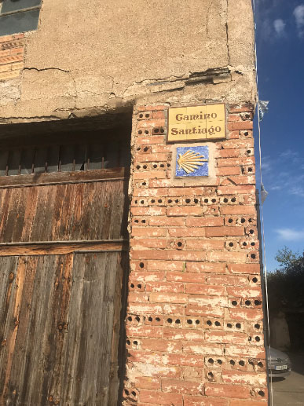
A Camino Journey ~ September 2019
“Hay tantos Caminos como peregrinos.”
There are as many roads (ways) as there are pilgrims.

Slide 2
A Camino Journey ~ September 2019
Camino History – Saint James, Santiago de Compostela
The Camino and popular culture
Preparing for Camino
Camino Routes
Camino Francés
Francés length & Time
Credencial
Compostela Requirements
Training
John’s Camino
Resources
Questions…

Slide 3
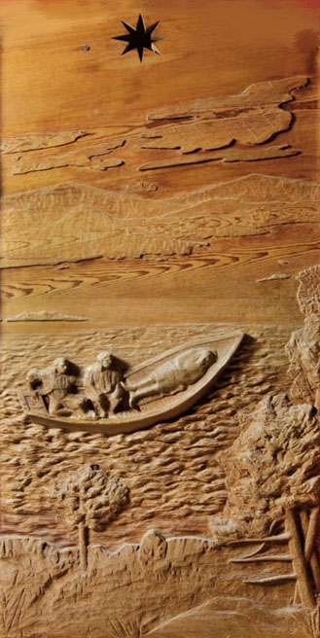
Saint James (Santiago in Spanish)
Sent to the Iberian Peninsula
Beheaded on return to Judea
Body returned to Iberian Peninsula
Buried and forgotten…rediscovered in the 9th century
Small chapel built, called Campus Stellae: ‘field of the star’. Compostela then became Santiago de Compostela, or Saint James of the Field of Stars.
Cathedral of Santiago de Compostela built in 1211
The tomb of St James sits behind the Cathedral Altar and can be viewed

Slide 4
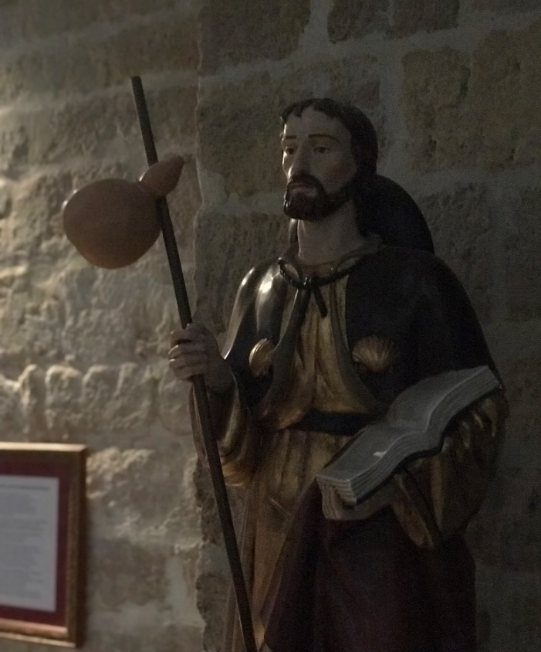
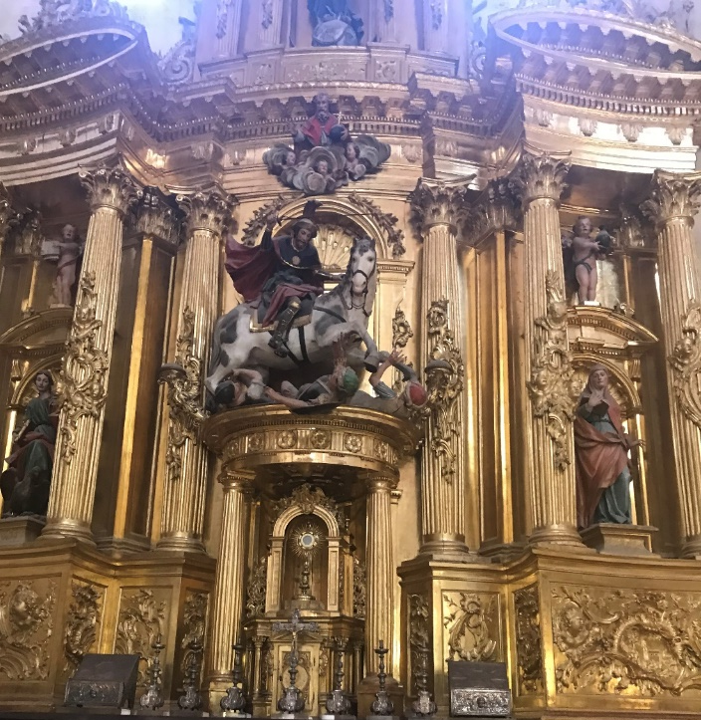
Pilgrimage
A pilgrimage is a journey, often into an unknown or foreign place, where a person goes in search of new or expanded meaning about their self, others, nature, or a higher good, through the experience. It can lead to a personal transformation.
The first recorded Camino pilgrimage was in 950.
They became very popular during Middle Ages
Pilgrims received indulgences
An indulgence is the remission of temporal punishment (time spent in purgatory) for sins
Almost died out due to the Bubonic (black plague 1347 – 1400) which reduced population by 30% to 50%
Wars between and among rising nations
The Reformation ( 1517-1521)… - reduced influence of Catholic Church – Luther’s objection to Indulgences

Slide 5
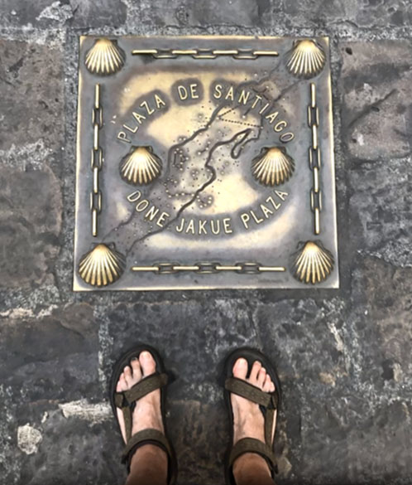
Current History
In the 1970s a few hearty adventurers began to explore the route
Religious and many secular Pilgrims
In 1972 six arrived in Santiago
In 1987 ~3,000 (twice as many men as women)
Now an international phenomenon
In 2010 (Holy Year) 272,000
In 2016 the number was ~278,000
In 2018 the number was 327,378 and half were men and half were women
In 2019 over 345,000 arrived Santiago & received Compostela
In 2020 Camino closed due to global pandemic
Pilgrims greet each other by saying “Buen Camino”

Slide 6
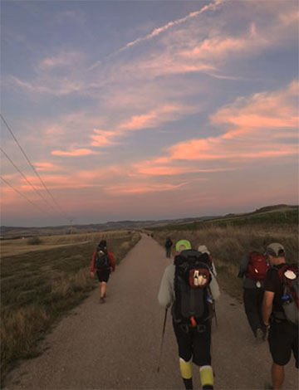
How to Make Your Camino
This is your Camino, Choose the Camino path that is the best fit for you: Frances, Portuguese, Primitivo…do it all, do it in segments. Choose your beginning and ending points.
You don’t need permission! Show up in France, Spain, Portugal. Check in at the Pilgrims office for information and documentation.
Prepare mentally & physically, possibly spiritually.
Do a little research; history, culture, etc
Walk at a comfortable pace and distance
Carry modest weight or ship bag every day
Take time to enjoy the journey – it is your destination.

Slide 7
Training
Training is highly recommended.
Begin to walk daily, then a few times per week.
Work up to walking several miles a day, for several days in a row.
If you want to walk 12 miles a day on the Camino, work up to walking 12 miles, then for two days back-to-back.
Hill training is very important, possibly the single most beneficial training you can do. In our area Crowder’s Mountain is a good option for hill training.
You will get hot, tired, sweaty, dusty, wet, possibly cold. Experience this in your training to know what you are in for. Do some training in rain to see how your rain gear works
Then start training with your backpack or daypack. If you plan to carry a backpack with all of your things aim to carry no more than 10% - 15% of body weight with upper limit of 22 lbs. Allow 2 pounds for water and a pound for snacks or lunch
Test footwear, socks, clothing, pack, poles, hats and hydration systems. Make sure these items don’t rub, chafe, or somehow annoy after many hours of walking. If they do, change them and test other options. Better to know now, than later.
Nothing will completely get you ready for the continuous days of walking the Camino
The more you prepare, the more enjoyable your experience will be.
Don’t be intimidated – Any mis-step or false start can be overcome

Slide 8
Communication
WiFi is most everywhere in Spain.
Free in most cases although not always the fastest or strongest
Can be slow in crowded albergues with many users
If you are in a bar or restaurant it is typically for paying customers.
Free calling options with WiFi include
WhatsApp, Wechat, Facebook Messenger, Google Hangout, Apple Facetime
A SIM card option – available in airports, large towns or cities. Get from provider (Orange, Movistar, Vodafone) not 3rd party.
Easy and very affordable (You will have a new number while in Europe)
Be sure it is working before leaving shop.
Or – purchase a disposable cell phone in Spain.

Slide 9
Travel Tips
When selecting flight schedule,
Remember travel days and rest days
Multi City ticket - Book arrival near starting point, departure near finish
Round trip ticket =
Extra time and expense for ground transportation to start/finish point
Allow one to two days to get to your starting point and rest before you start walking
Jet lag will get you!
Recommend a rest/tourist day in Santiago, very nice city, savor your experience
John’s Example:
Charlotte to Boston, Boston to Madrid R/T
Train Madrid to Pamplona, rest (if you qualify, senior discount is substantial)
Bus to Saint Jean, rest, begin following morning

Slide 10
Equipment
Equipment
Guide Book: Brierley’s book most common
Backpack ~ 35 to 45 liters (or daypack + suit case)
Trek poles – sectional
Water bottle/s (juice or drink bottles bought locally)
Headlamp for before sunrise
Walking shoes: boots, trail running, light weight hiking
Sandals after day’s walk – let your shoes dry (John brought hiking sandals)
Sun protection – lotion, broad hat
Rain protection – try it out before you go
Good quality hiking socks
Lightweight, quick dry/performance clothing
Towel, sleeping bag liner (albergues), 2 prong adapter, phone + charger, personal hygiene, medications

Slide 11
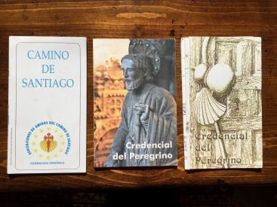
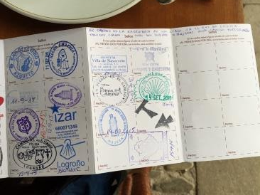
Saint Jean and Pilgrim’s Office
Pick up and/or have your Pilgrim’s Passport (Credencial del Peregrino) stamped
Check conditions for specific routes: weather conditions in the mountains can change quickly.
Always heed the advice of the Pilgrim’s office
“Credencial del Peregrino”: document to show you are a pilgrim. (and a cool souvenir)
Albergues, cafes, museums, etc. will stamp it
Without it you can’t stay in most Albergues…
You will not receive a Compostela upon reaching Santiago without it being properly stamped.
One Compostela available for religious or spiritual reasons
A different one for other reasons
Credential Available free from American Pilgrims Website

Slide 12
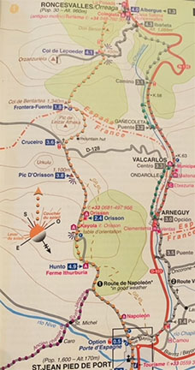
Map and Daily Hike Profile
Stage 1 of the Camino Frances
Map 1 shows elevation + distance covered
Map 2 shows trail, stops + distances along your route
Source: John Brierley Book

Slide 13
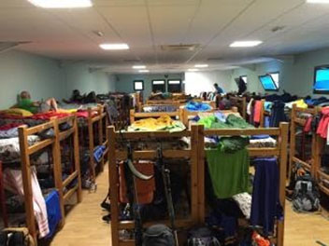
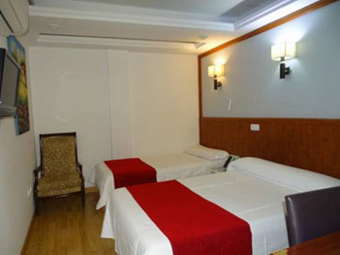
Where to Stay
Alburgue – hostel-like, many beds (and Pilgrims) to a room, shared bathrooms and showers
Pension – usually private room and shared bath
Casa Rural (like B&B in rural setting)
Hotels - in cities and larger towns
Parador – luxury hotel usually in historical building
Santiago and three other locations
Find these in Brierly and on Booking.com or other online site
Total Daily Cost
Meals - 10 to 15 each
Bed – 15 +
Other – 15 Lunch/Snack/Beverages
Daily total - 45 to 70 E per day
Consider or sharing a pension, casa rural room, similar cost to alburgue (shared cost)

Slide 14
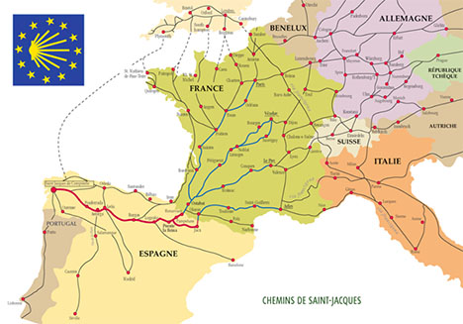
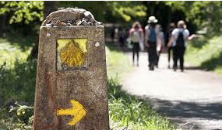
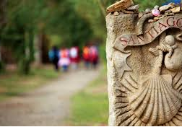
El Camino de Santiago / The Way of Saint James
Yellow arrows mark the way, guide you to Santiago de Compostela.
Santiago de Compostela
Norte/Primitivo
Frances/Le Puy
Frances
Saint Jean PdP
Portuguese
Scallop shells represent the many paths leading to Santiago de Compostela
Madrid
Many Caminos lead to Santiago de Compostela, Camino Frances is the most popular. St. Jean Pied de Port to Santiago de Compostela = 790 kilometers/490 miles. Because there are so many pilgrims, infrastructure has grown to support this volume.

Slide 15
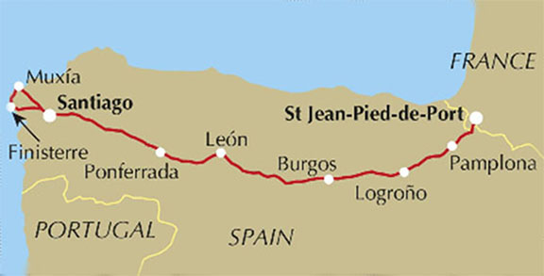
El Camino de Santiago / Camino Frances
My Camino started 19 September in Saint Jean Pied de Port, France with the goal of walking to Santiago de Compostela. At 12 miles/day I estimated about 45 days of walking. Lodging and food is very reasonable, 2019 cost about $70/day or $3,150 for my days on the Camino. Additional costs for travel to/from Spain, insurance, etc.

Slide 16
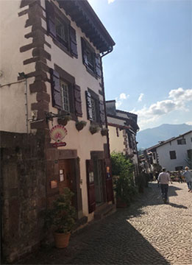
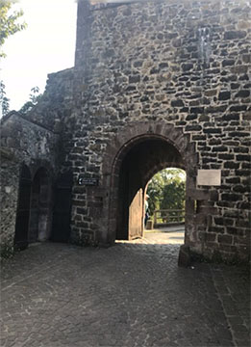
Saint-Jean-Pied-de-Port
A charming, small, foot of the mountain village. Strong Basque influence and presence. I arrived the morning 0f 18 September to acclimate. Food, architecture, history is great and it is crawling with peregrinos/peregrinas. You will meet co-travelers you will see for weeks…
My Auberge (hostel) Azkorria
French Gate (north/eastern wall)

Slide 17
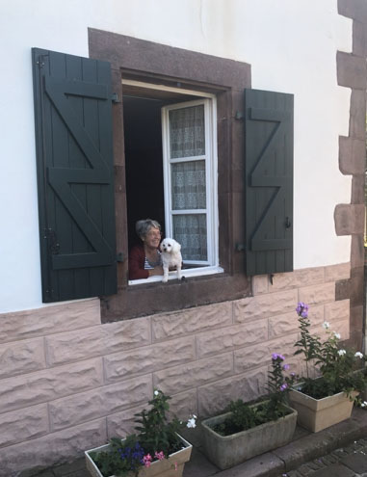
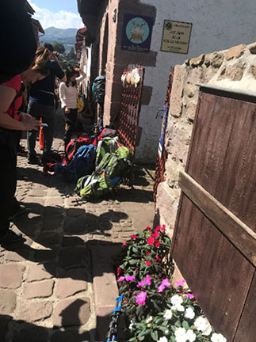
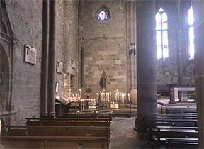
Pilgrim’s Check-In
Prior to Pilgrim’s Mass

Slide 18
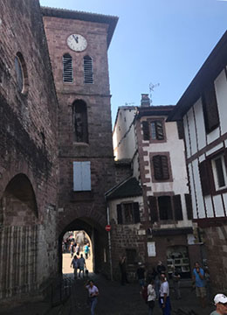
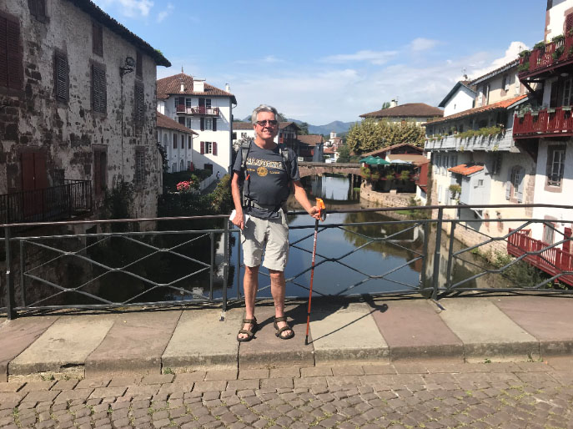
Day 1: Saint Jean Pied de Port to Orisson
Uphill: 8 kilometers, 4.5 miles, 3 hours walking
Route Napoleon. Trail is mix of asphalt and gravel or rocky surfaces. The Camino begins by exiting the Spanish Gate at the west end of St. Jean PdP. Refuge Orisson 12 per room.
Leaving Saint Jean, walking to Orisson
Where am I?
September 19, 2019

Slide 19
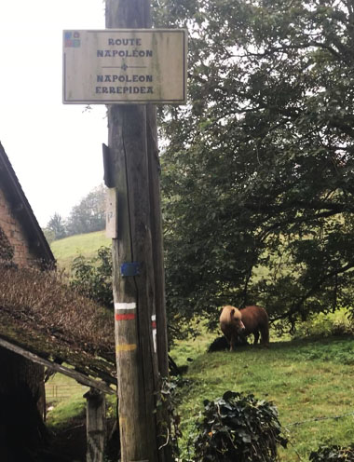
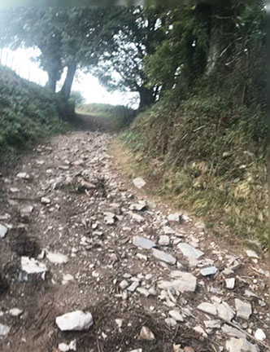
Day 1

Slide 20
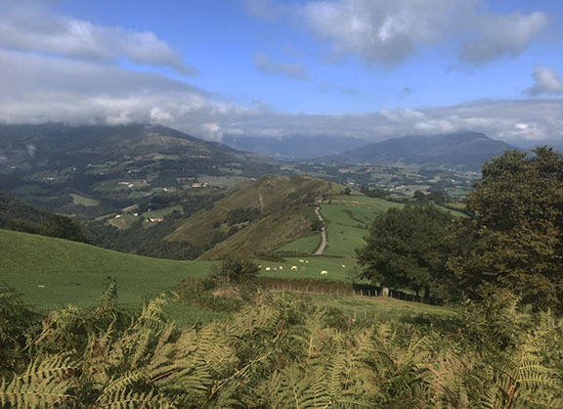
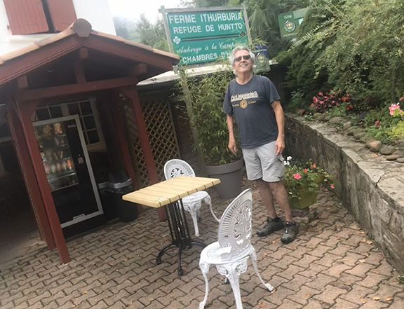
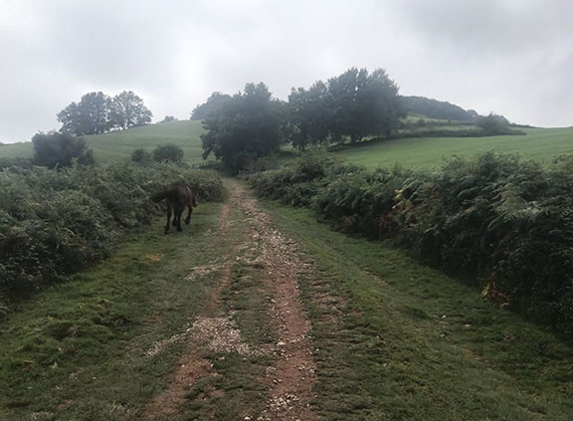
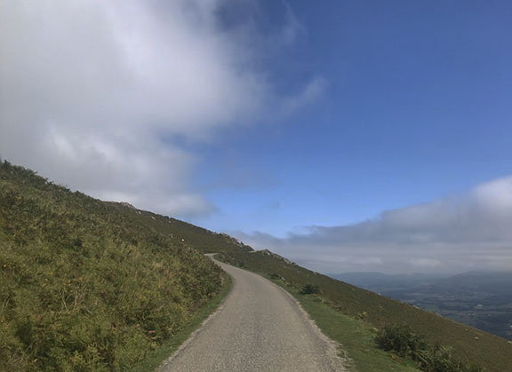
Day 1

Slide 21
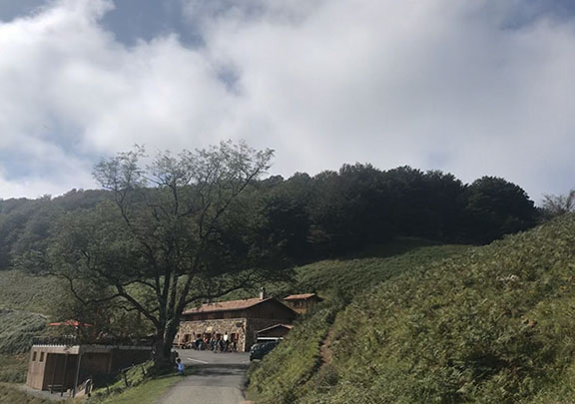
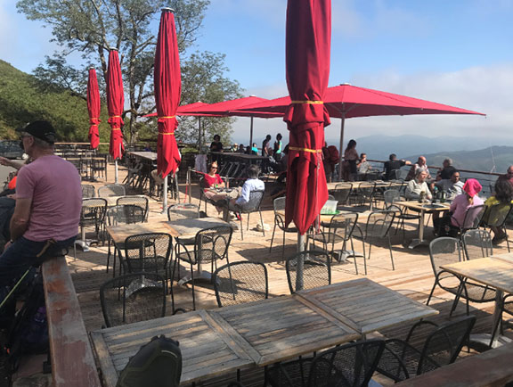
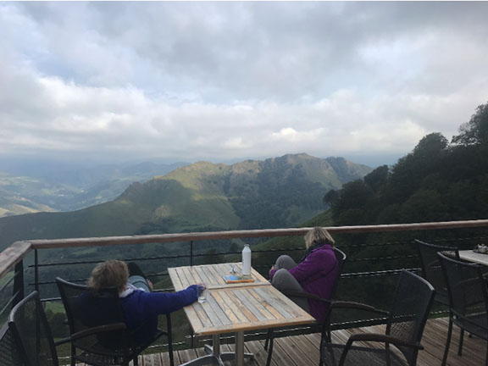
End of Day 1
Views from the deck were spectacular, and the beers equally good! Day concluded with a communal style dinner with introductions of your name, why you’re here, and why you are walking.

Slide 22
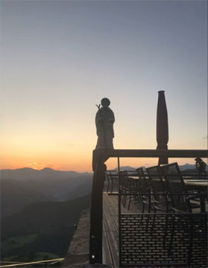
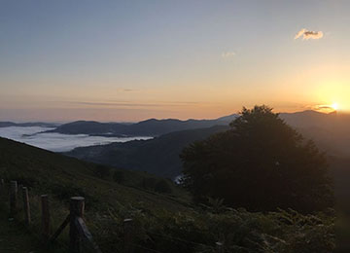
Day 2: Orisson to Roncesvalles
80% Uphill: 17 kilometers, 11.1 miles, 6 hours walking
Route Napoleon. Beautiful clear, brisk morning. Strong in-your-face winds blew me sideways. Strenuous up and downhill, exhausted by days end.
Incredible scenery walking over the Pyrenees, then descending into Roncesvalles.
September 20

Slide 23
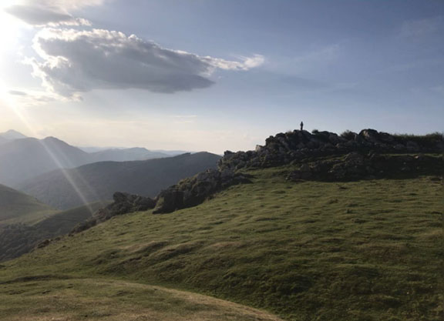
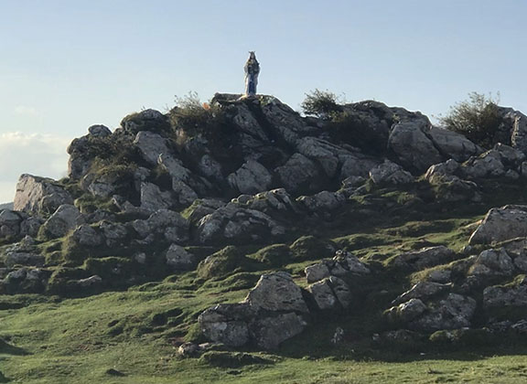
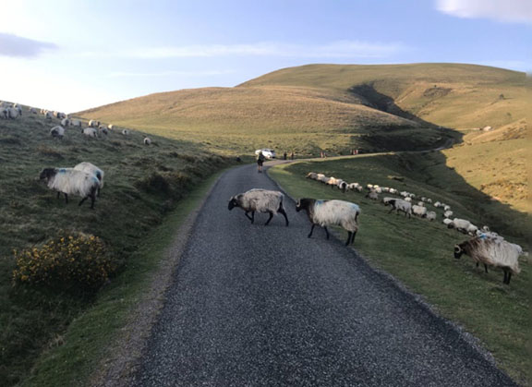
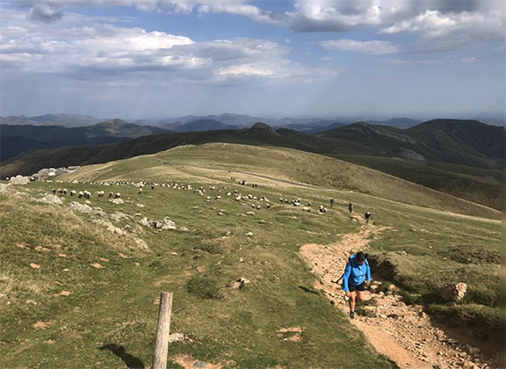
Day 2

Slide 24
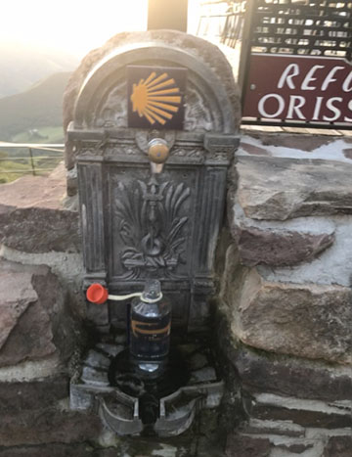
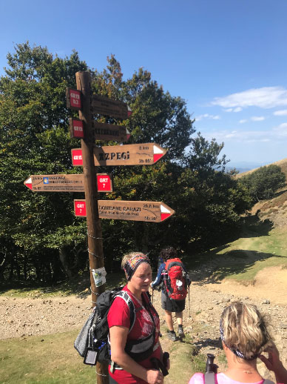
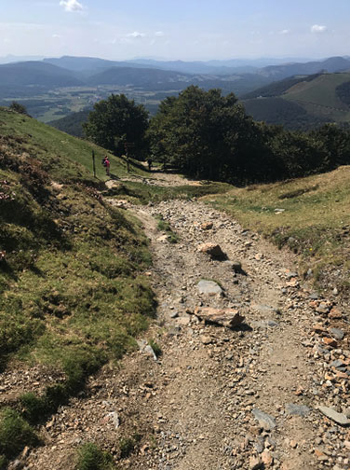
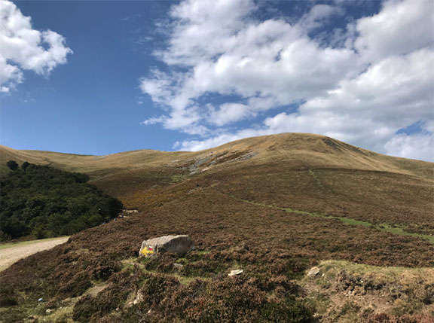
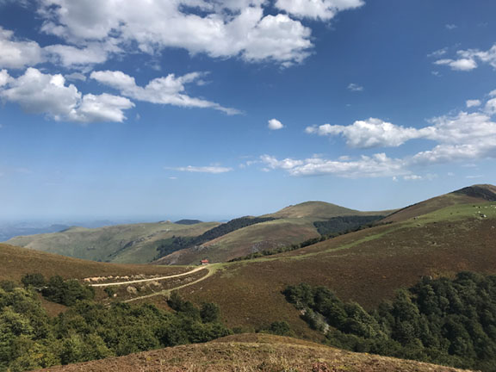
Day 2

Slide 25
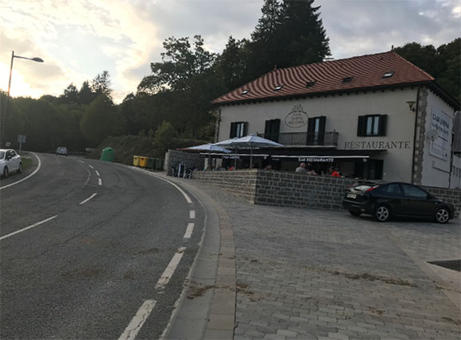
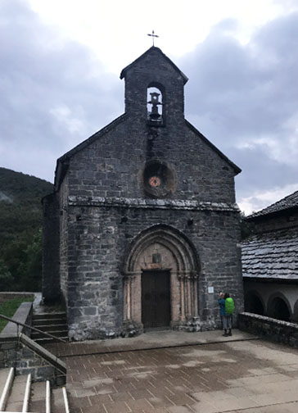
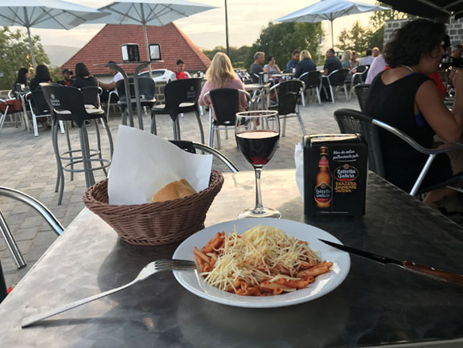
Day 2

Slide 26
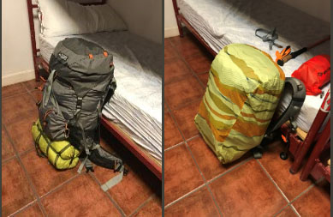
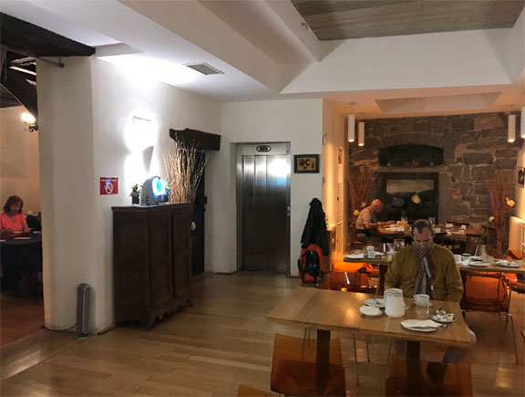
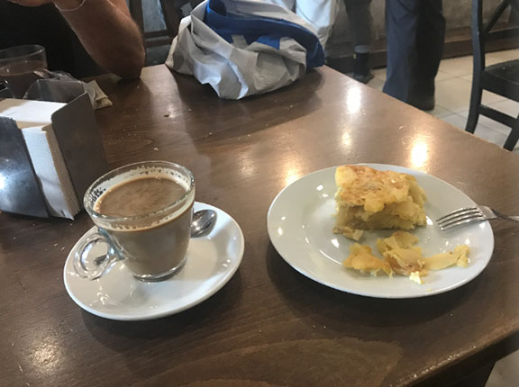
Day 3: Roncesvalles to Zubiri
Mix of level, some up and downhill: 22 kilometers, 13.6 miles, 6 hours walking. Steady, soaking rain. Through Burgette, Hemingway town. Trails slippery all day. In the hills before Zubiri is where Roland blew his horn Oliphant before being killed in battle (epic poem Song of Roland).
Once walking realized rain is a part of the experience. This is why I prepared. Learned to step on the cracks, not pavers. Enter Zubiri over the Puente de la Rabia, Rabies Bridge.
September 21

Slide 27
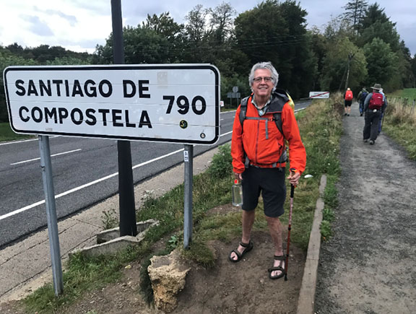
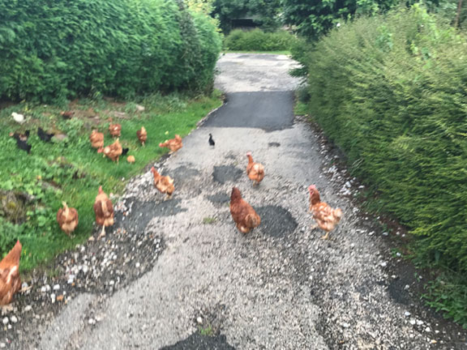
Day 3

Slide 28
Near the Pasos de Roland

Slide 29
Day 4: Zubiri to Pamplona
Mostly downhill, some uphill: 21 km, 13 miles, 6 hours walking. Steady rain gave way to sun. A welcome stop in Zuriáin when rain let up.
Today provided time for reflection and contemplation. A beautiful walk.
September 22

Slide 30
Day 4

Slide 32
Day 5: Pamplona to Puente la Reina
Flat, steep uphill, steep downhill, flat: 23.8 kilometers, 14.8 miles, 7+ hours walking
Exit Pamplona, old village stop at Zariquiegui. Rocky farmland, uphill to Alto del Perdon (Height of Forgiveness). Very rocky descent. I was joined by a good friend
Walked out of Pamplona through freshly plowed fields. Alto de Perdon has iconic iron sculptures of Perigrinos as you pass over the top.
September 24

Slide 33
Sorry Frans from Belgium
Buen Camino

Slide 35
Final stretch into Puente La Reina on a hot, dusty day, exhausted after 15 miles. Dinner and beers on the street, our Casa Rural was down a long, wandering alley.

Slide 36
Day 6: Puente la Reina to Estella
Uphill, then gentle up and downs and level: 21.9 kilometers, 13.6 miles, 6 hours walking
We leave crossing the 12th Century Queen’s Bridge over the Rio Arga. We’ll cross 2 other rivers and pass through villages influenced by Knights Templar, and Lorca, helping pilgrims since 1066.
September 25

Slide 39
Roman road, 2,000 years old

Slide 40
Day 7: Estella to Los Arcos
Uphill first 10k, then mostly downhill: 21.5 kilometers, 13.4 miles, 6 hours walking. We stop at an iron artist shop before Bodega Irache and the famous wine fountain. Beautiful countryside and ancient villages then celebrate Australian friend John’s 73rd birthday .
Bodega Irache offers water and wine to pilgrims for free. A tradition is to drink from your scallop shell.
September 26

Slide 46
Day 8: Los Arcos to Logroño
Steep up/down in the middle, then mostly level: 27.8 kilometers, 17.3 miles, 7+ hours walking. Very long walk. Past 12th century church linked to the Knights Templar and based on the Holy Sepulchre in Jerusalem. Viana is a beautiful old town that has supported pilgrims since the 15th century.
September 27

Slide 48
Logrono celebrated their annual wine festival the night we arrived.

Slide 49
Day 9: Logroño to Navarrete
Mostly uphill: 12.7 kilometers, 7.9 miles, 4 hours walking. Busy city streets then very long park and greenway to the trails outside of Logroño. The Camino continues through the Rioja wine country. In Navarrete I connect with Camino friends over fantastic tapas, good, cold beer, excellent local red and white wine for 1.5€ per glass.
September 28

Slide 51
Peregrino Koos from the Netherlands

Slide 52
Day 10: Navarrete to Nájera
Mostly uphill: 16.2 kilometers, 10 miles, 4 hours walking
Beautiful morning and walk through the heart of Rioja wine country. Nice food break in the middle of nowhere, then on to Nájera, a very cool Camino city. The church and monestary date to the 1100’s, an especially spiritual place
September 29

Slide 54
Monasteria Santa Maria de la Real
A very spiritual, “thin place”

Slide 56
Day 11: Nájera to Santo Domingo de la Calzada
Level to long uphill, then gentle downhill: 21.3 kilometers, 13.2 miles, 6 hours walking
Through Azofra, population 250, serving pilgrims since the 12th century. Splurged and stayed in the Parador at SDdlC, a 14th century pilgrim’s hospital converted to a hotel.
September 30

Slide 57
Some days are not as photogenic as others but the paella was awesome…

Slide 59
Day 12: Santo Domingo de la Calzada to Belorado
Gradual up and downhill: 22.4 kilometers, 13.9 miles, 6 hours walking
Depart over an 11th century bridge. Path leads from Rioja into Castilla Y Leon, Spain’s largest autonomous region. Fantastic breakfast stop; food truck with great food and freshly squeezed juice. Bathrooms were inside a converted shipping container. Stopped for tea at a very old alburque, nice people and Camino giving spirit here.
October 1

Slide 62
The church in Belorado adjoins cliffs, a hermit’s residence carved into the rock. Paul at Casa Waslaza was outstanding.
Paul, Casa Waslaza

Slide 63
Day 13: Belorado to San Juan de Ortega
1,000 ft gain first 15k, then slight downhill: 24.2 kilometers, 15 miles, 7 hours walking
Passed through Villafranca Montes de Oca, helping pilgrims since the 9th century. 2 memorials on the way; 1 for a pilgrim and another for 200 people killed during the Spanish civil war. Stayed in a slightly funky, cool alburque in SJdO, a very small village.
October 2

Slide 64
Alburgue @ San Juan de Ortega
Alburgue @ San Juan de Ortega

Slide 65
The church in San Juan de Ortega was refreshing: simple, not overly embellished with brass/bronze/gold/silver metals. Solemn, not macabre and grotesque with wounded martyrs and saints.

Slide 66
Day 14: San Juan de Ortega to Burgos
Mostly level to slight downhill: 26.1 kilometers, 16.2 miles, 7 hours walking
Pass through Age, population 60 and nearly 1,000 years old. Through Atapuerca, with human activity 1.5 million years ago, the oldest known in Europe. After walking along a busy highway and airport fence, opted to bus into Burgos for the last mile.
October 3

Slide 69
Burgos
Excellent city. Outstanding tapas; La Favorita, Michelin recognized. Old city gate. Magnificent cathedral (UNESCO World Heritage site), including burial place of El Cid. Very walkable.
Blisters were so bad I visited a podiatrist, needed (at least) 2 full days rest. Decided to rent a bike in Burgos and drop it in Leon to rest my feet.
Burgos Cathedral
City Gate, Burgos
October 4-6

Slide 70
Burial place of El Cid

Slide 72
Burgos Cathedral, 2 very different depictions of Saint James: a kind, gentle pilgrim (right) and St. James Matamoros*, the Moor slayer (left).
*from the battle of Clavijo – historians say this is a mythical battle that never occurred

Slide 73
Day 15: Burgos to Castrojerez
Level for 15k, steep uphill then down: 41.1 kilometers, 25.5 miles, 5 hours biking
This is where the Meseta begins. Largely flat, but with steep hills in between. Beautiful small village of Hontanas (less than 100 permanent residents), nice food and stay in Castrojerez.
October 7

Slide 75
Hontanas

Slide 77
Day 16, 17: Castrojerez/Fromista/Calzadilla de la Cueza
Varied terrain; asphalt, gravelly, rocky roads: 24.9 kilometers, 15.5 miles, 5 hours biking
Extremely steep uphill then steep downhill. Dusty and hot afternoon. Nice old villages and churches along the way.
October 8

Slide 80
Day 18: Calzadilla de la Cueza to…
Rode 12K, crashed just short of Moratinos. Local Alburque owner Bruno drove me to Sahagun hospital, sent by ambulance to Leon, 3 days in the hospital with costillas rotas (broken ribs). Roommate Valentin and his wife were lifesavers too…
Valentín
Bruno
October 9

Slide 81
Leon
My Camino ended in Moratinos, then Leon. I’ll return in Fall of 2022 to complete it. I watched the sun set in Leon, had dinner, and returned to my hotel. As I ordered a Spanish brandy a voice said “John”. I looked over and a Camino friend, Jack said hello. It was the perfect way to wrap up a Camino, with another pilgrim…
Leon

Slide 82
Learnings
Every step, day is profound. Keep a sense of wonder, awe, curiosity, adventure, gratitude, humility. Take time to stop and visit churches, sights.
Rest day every 5 or 6 days. Physically relax & recover
Feet. Be aware and take care of them. Stop and take care of them…
Don’t Panic. Prepare for everything, but the unexpected may happen
Hydrate and eat. 2+ litres water/day, 3,000 calories
Make friends. We are walking as individuals, this is a community of people walking with a singular purpose.
It’s OK (and convenient!) to ship your stuff ahead, lighten your load…
The Camino provides. Care and provide for others.
Don’t pass the first opportunity (Coffee, etc)
Research so you don’t know what you’re missing.
Take “just enough” technology. I used sim card by Orange and WhatsApp.
Keep a daily journal: begin/finish, meals, lodging…
Alburques get tiresome. Consider sharing a room.
Humor: If there isn’t a god, then why are there
all of these churches?

Slide 83
EL FÍN
"Heaven is under our feet as well as over our heads.” - Henry David Thoreau

Slide 84
Charlotte Chapter American Pilgrims on the Camino
As a Chapter we share Camino de Santiago experiences, provide mentoring for new walkers, support each other, have fun, offer support and camaraderie for returning walkers. We inspire all who seek the spirit of the Camino to connect with the global community of pilgrims
Local Activities – walks, hikes, potlucks, Camino presentations, evening socials
Weekly Coffees:
1st Thursday 9:00am – Mugs Coffee, Park Road, Charlotte
2nd Thursday 10:00am – Davidson Village Green (Rain = Summit)
3rd Thursday 6:00pm – Fort Mill/South Charlotte
4th/5th Thursday 9:00am – Zoom
Local Facebook Group: Charlotte Pilgrims (205 members)
Monthly email + calendar of events

Slide 85
Resources
Movies
The Way (fall 2011)
Six Ways to Santiago (2013)
I’ll Push You (2017)
Camino Skies (2019)
Netflix Movie: Footprints – The Path of Your Life
Individual videos can be found on web - Youtube
Internet
Rick Steves’ Europe PBS
Season 6, Episode 10 = Northern Spain & Camino

Slide 86
Websites + Social Media
Charlotte Camino Pilgrims Facebook Page: https://www.facebook.com/groups/1418344158467833/
American Pilgrims on the Camino Facebook Page: https://www.facebook.com/groups/AmericanPilgrims/
CAMIGAS – Buddy system for women on the Camino – Public FB https://www.facebook.com/groups/CaminoBuddySystemForWomen
American Pilgrims on the Camino (national) website: http://www.americanpilgrims.org/ : Extensive list of links
FAQS, Books, Films, Essays & writings
International based Camino Forum: https://www.caminodesantiago.me/community/
Camino Experts at: https://caminoways.com/
Adventure Camino: www.adventurecamino.com
Offline Guide for your phone: http://wisepilgrim.com
Transportation - plane, train, bus, ferry and automobile: https://www.rome2rio.com **

Slide 87
Contact
John Kennedy
78slug@gmail.com
704 682-0628

